Slide 1

Date: 28/10/2024
Group Name: A147 Name of Student Presenting: Haroon

Slide 2
This dataset is interesting to us because this dataset is interesting because it provides a clear view into India’s competitive aviation market, offering insights on pricing strategies, peak travel timings, and traveler preferences on high-demand routes. It’s valuable for both travelers looking to optimize costs and for businesses studying market behavior in one of the world’s largest aviation hubs. Our Independent variable is: Flight Duration This Independent variable datatype is : Continuous Our Dependent variable is: Price This Dependent variable datatype is : Continuous
Dataset ID: DS115

Slide 3
Is there any correlation between Flight duration & Ticket prices for domestic flights in India? Or Is there any correlation between Flight duration & Ticket prices for domestic flights departing from delhi in India?
Our Research Question is:

Slide 4
1. Null hypothesis (H_{o}): The null hypothesis states that there is no relationship between flight duration and ticket prices for domestic flights in India. 2. Alternative hypothesis (H₁): The alternative hypothesis states that there is a relationship between flight duration and ticket prices for domestic flights in India.

Slide 5
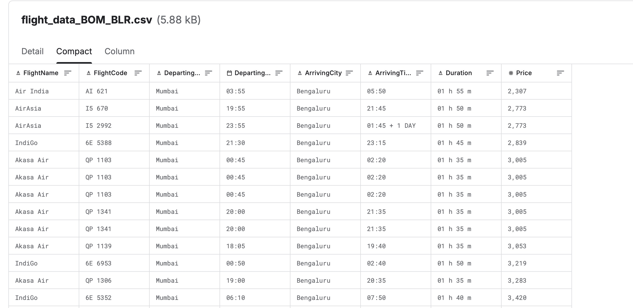
Dataset – Airline ticket price in India DS-115

